Slide 1
Comparative Genomics and Visualisation – Part 2
Leighton Pritchard

Slide 2
Part 2
Part 1
Experimental Comparative Genomics
Bulk and Whole Genome Comparisons
Genome Features
Who let the –logues out?
Finishing The Hat

Slide 3
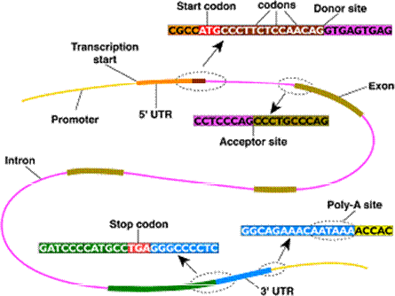
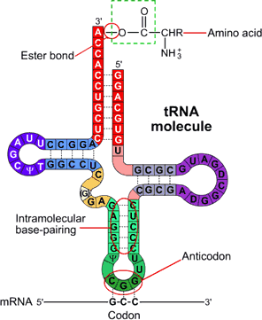
Genome Features
Genes:
translation start
introns
exons
translation stop
translation terminator
ncRNA:
tRNA – transfer RNA
rRNA – ribosomal RNA
CRISPRs – bacterial and archaeal defence (genome editing)
many other classes (including enhancers)

Slide 4
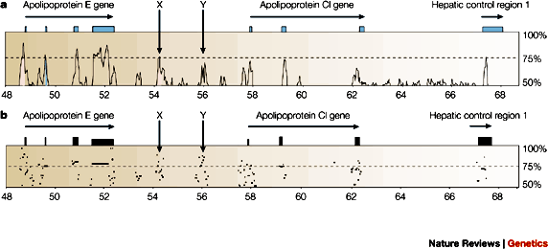
Genome Features
Regulatory sites
Transcription start site (TSS)
RNA polymerase binding sites
Transcription Factor Binding Sites (TFBS)
Core, proximal and distal promoter regions
Repetitive Regions and Mobile Elements
Tandem repeats
(retro-)transposable elements
Alu has ≈50,000 active copies in human genome
Phage inclusion (bacteria/archaea)
human v mouse comparison
Pennacchio & Rubin (2001) Nat. Rev. Genet. doi:10.1038/35052548

Slide 5
Genome Feature Identification
Gene Finding:
Empirical (evidence-based) methods:
Inference from known protein/cDNA/mRNA/EST sequence
Inference from mapped RNA reads
Ab initio methods:
Identification of sequences associated with gene features:
TSS, CpG islands, Shine-Dalgarno sequence, stop codons, etc.
Inference from genome comparisons/conservation
Liang et al. (2009) Genome Res. doi:10.1101/gr.088997.108
Brent (2007) Nat. Biotech. doi:10.1038/nbt0807-883
Korf (2004) BMC Bioinf. doi:10.1186/1471-2105-5-59

Slide 6
Genome Feature Identification
Finding Regulatory Elements (short, degenerate):
Empirical (evidence-based) methods:
Inference from protein-DNA binding experiments
Inference from coexpression
Ab initio methods:
Identification of regulatory motifs (profile/other methods):
TATA, sigma-factor binding sites, etc.
statistical overrepresentation
Identification from sequence properties
Inference from sequence conservation/genome comparisons
Zhang et al. (2011) BMC Bioinf. doi:10.1186/1471-2105-12-238
Kilic et al. (2013) Nucl. Acids Res. doi:10.1093/nar/gkt1123
Vavouri & Elgar (2005) Curr. Op. Genet. Devel. doi:10.1016/j.gde.2005.05.002

Slide 7
Genome Feature Identification
All prediction methods result in errors
All experiments have error
Genome comparisons can help correct errors
[OPTIONAL ACTIVITY] – useful for exercise
predict_CDS.md Markdown
Other options for prokaryotic genecalling:
Glimmer (http://ccb.jhu.edu/software/glimmer/index.shtml)
GeneMarkS (http://opal.biology.gatech.edu/)
RAST (http://rast.nmpdr.org/)
BASys (https://www.basys.ca/), etc.
Options for eukaryotic genecalling:
GlimmerHMM (http://ccb.jhu.edu/software/glimmerhmm/)
GeneMarkES (http://opal.biology.gatech.edu/gmseuk.html)
Augustus (http://augustus.gobics.de/), etc.

Slide 8

Who Let The -logues Out?
Evolutionary relationships of genome features can be complex.
We require precise terms to describe relationships between genome features.

Slide 9
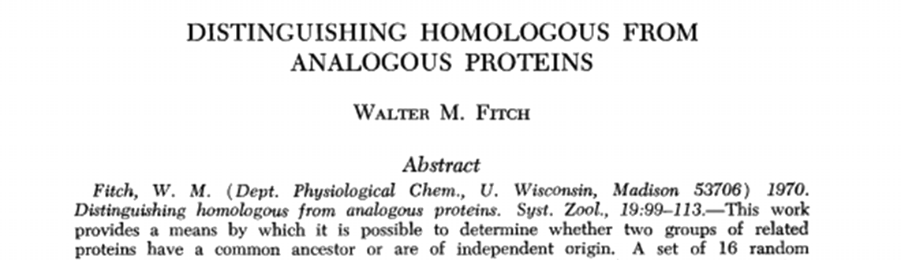
Comparing Gene Features
Given gene annotations for more than one genome, how can we organise and understand relationships?
Functional similarity (analogy)
Evolutionary common origin (homology, orthology, etc.)
Evolutionary/functional/family relationships (paralogy)
Terms first suggested by Fitch (1970) Syst. Zool. doi:10.2307/2412448

Slide 10
Attack of the –logues
Technical terms describing evolutionary relationships
Homologues: elements that are similar because they share a common ancestor (NOTE: There are NOT degrees of homology!)
Analogues: elements that are (functionally?) similar, possibly through convergent evolution and not by sharing common ancestry
Orthologues: homologues that diverged through speciation
Paralogues: homologues that diverged through duplication within the same genome
(also co-orthologues, xenologues, etc.)

Slide 11
Attack of the –logues
genome
ancestral genome feature
time

Slide 12
Attack of the –logues
genome
ancestor: ftA
speciation
time
species1:ftA
species2:ftA
orthologues
Orthologues: homologues that diverged through speciation

Slide 13
Attack of the –logues
genome
ancestral copy:ftA
duplication
time
copy 1:ftA
copy 2:ftA’
paralogues
Paralogues: homologues that diverged through duplication within the same genome

Slide 14
Attack of the –logues
genome
ancestor:ftA
speciation
time
species1:ftA
species2:ftA
duplication
species1:ftA’
species1:ftA
species2:ftA
in-paralogues
orthologues
out-paralogues

Slide 15
Attack of the –logues
genome
ancestor:ftA
speciation
time
species1:ftA
Species2:ftA
duplication
species1:ftA’
species1:ftA
species2:ftA
species2:ftA’
in-paralogues
orthologues
in-paralogues
out-paralogues

Slide 16
Attack of the –logues
BUT: biology is not well-behaved: relationships can be difficult to infer
Gene loss occurs
Homologues can diverge – sometimes very widely: hard to recognise
Reconstructed evolutionary trees for speciation events may not be robust
Kristensen et al. (2011) Brief. Bioinf. doi:10.1093/bib/bbr030

Slide 17
Attack of the –logues
historical events
genome
ancestor:ftA
speciation
Species2:ftA
time
species1:ftA
duplication
species1:ftA’
species1:ftA
species2:ftA
species2:ftA’
extensive divergence
species1:ftA?
species1:ftA
species2:ftA?
in-paralogues
out-paralogues/co-orthologues?
contemporary
sequence
(co-)orthologues?
Current classifications of orthology/paralogy are inferences

Slide 18
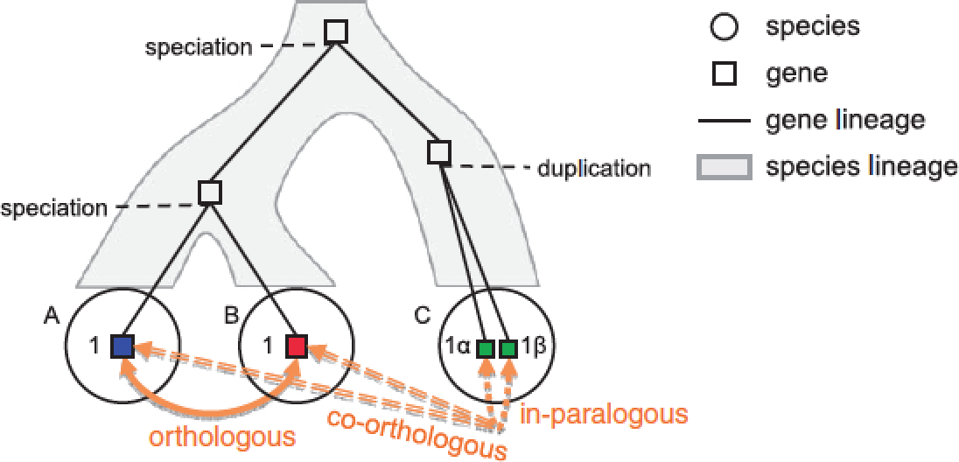
Attack of the –logues
BUT: biology is not well-behaved: relationships can be difficult to infer
Gene loss occurs
Homologues can diverge – sometimes very widely: hard to recognise
Reconstructed evolutionary trees for speciation events may not be robust
Some resources and tools ‘bend’ definitions, e.g. Ensembl Compara and OrthoMCL.
http://www.ensembl.org/info/genome/compara/ homology_method.html
Kristensen et al. (2011) Brief. Bioinf. doi:10.1093/bib/bbr030

Slide 19
Note on “Orthology”
Frequently abused/misused as a term
“Orthology” is an evolutionary relationship, often bent into service as a functional descriptor
Strictly defined only for two species or clades!
(cf. OrthoMCL, etc.)
Orthology is not transitive (A is orthologue of C and B is orthologue of C does not imply A is an orthologue of B)
(cf. EnsemblCompara definitions)
Storm & Sonnhammer (2002) Bioinformatics. doi:10.1093/bioinformatics/18.1.92

Slide 20
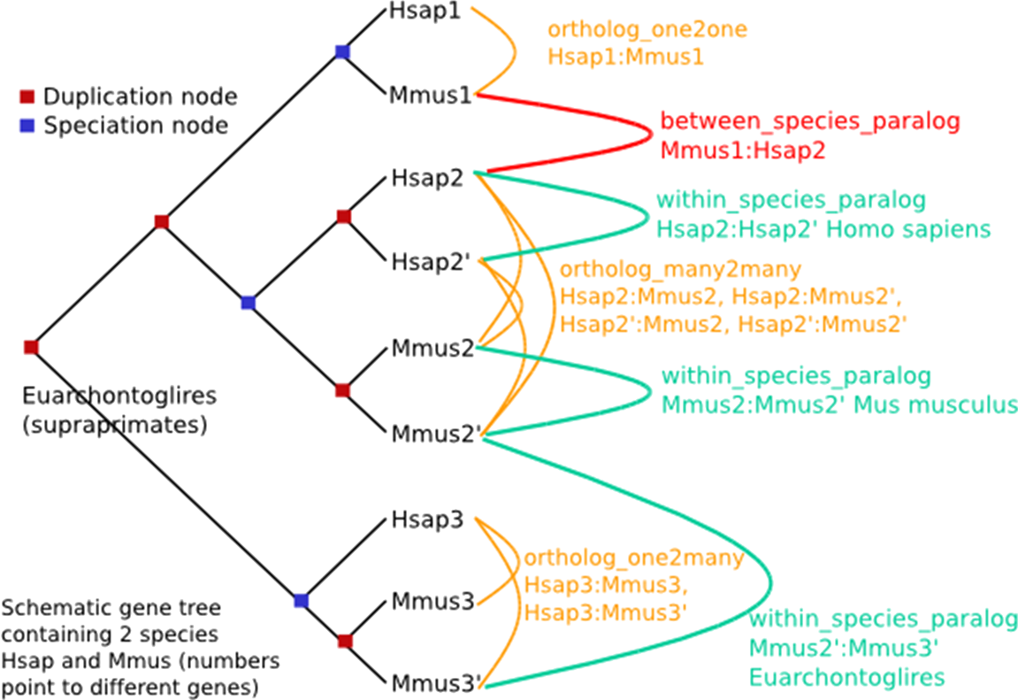
Ensembl Compara definitions
within_species_paralog: same-species paralogue (in-paralogue)
ortholog_one2one: orthologue
ortholog_one2many: orthologue/paralogue relationship
orthology_many2many: orthologue/paralogue relationship
NOTE: the taxonomy may not always be correct…
Vilella et al. (2009) Genome Res. doi:10.1101/gr.073585.107

Slide 21
“The Ortholog Conjecture”
Without duplication, a gene is unlikely to change its basic function, because this would lead to loss of the original function, and this would be harmful.

Slide 22
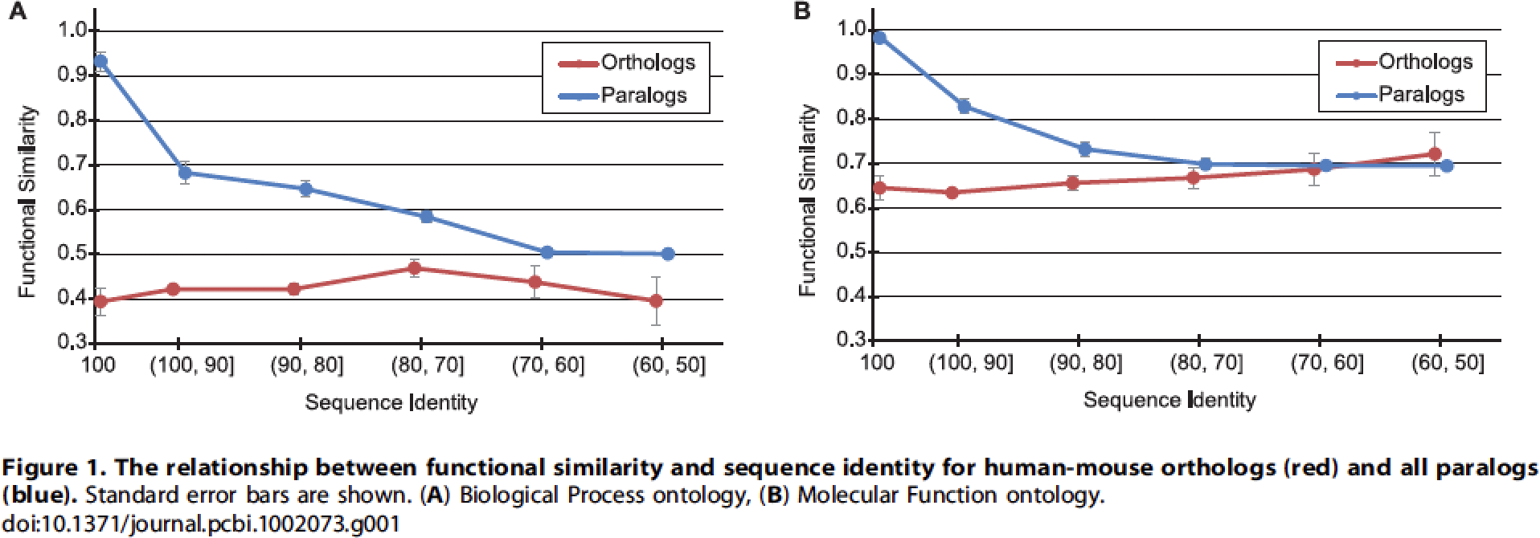
Problems with the Ortholog Conjecture
Nehrt et al. (2011) say:
Paralogues better predictor of function than orthologues
∴ conjecture is false!
Cellular context better for protein function inference
Function defined from Gene Ontology (GO)
Nehrt et al. (2011) PLoS Comp. Biol. doi:10.1371/journal.pcbi.1002073
Chen et al. (2012) PLoS Comp. Biol. doi:10.1371/journal.pcbi.1002784

Slide 23
Problems with the Ortholog Conjecture
But do we understand function well enough to test the conjecture?
Chen et al. (2012) say: “No”
“examination of functional studies of homologs with identical protein sequences reveals experimental biases, annotation errors, and homology-based functional inferences that are labeled in GO as experimental. These problems […] make the current GO inappropriate for testing the ortholog conjecture”
Expression level similarity is more similar for orthologues than paralogues (but is this “function”…?)
Nehrt et al. (2011) PLoS Comp. Biol. doi:10.1371/journal.pcbi.1002073
Chen et al. (2012) PLoS Comp. Biol. doi:10.1371/journal.pcbi.1002784

Slide 24
Finding “Orthologues”
The process of finding evolutionary (and/or functional) equivalents of genes across two or more organisms’ genomes.

Slide 25
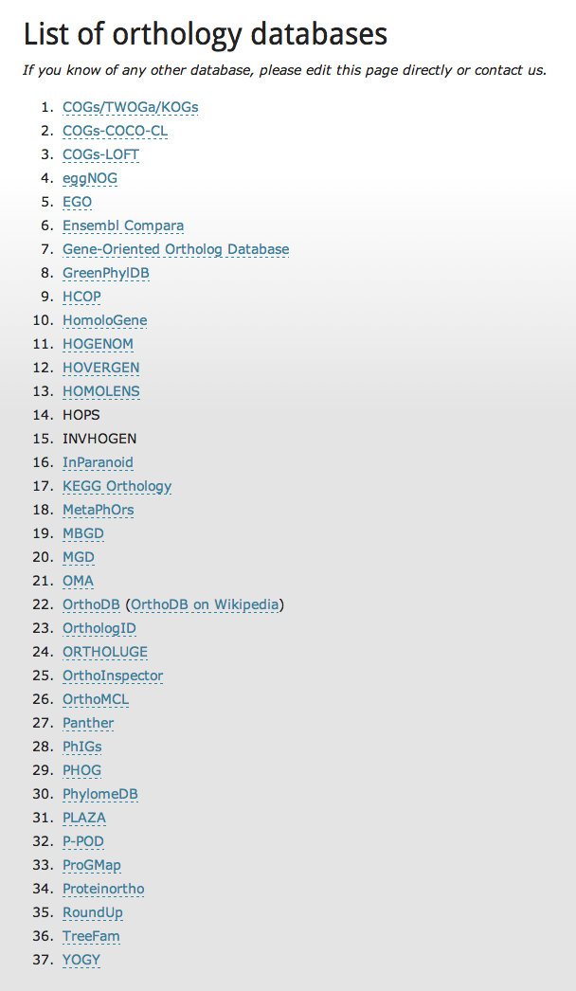
Why are “orthologues” so important?
Orthology formalises the concept of corresponding genes across multiple organisms.
Evolutionary
Functional? (“The Ortholog Conjecture”)
Applications in:
Comparative genomics
Functional genomics
Phylogenetics, …
Many (>35) databases attempt to describe orthologous relationships
http://questfororthologs.org/orthology_databases
Dessimoz (2011) Brief. Bioinf. doi:10.1093/bib/bbr057

Slide 26
How to find orthologues?
Many published methods and databases:
Pairwise between two genomes:
RBBH (aka BBH, RBH, etc.), RSD, InParanoid, RoundUp
Multi-genome
Graph-based: COG, eggNOG, OrthoDB, OrthoMCL, OMA, MultiParanoid
Tree-based: TreeFam, Ensembl Compara, PhylomeDB, LOFT
Methods may apply different - or refined - definitions of orthology, paralogy, etc.
Salichos et al. (2011) PLoS One. doi:10.1371/journal.pone.0018755
Trachana et al. (2011) Bioessays doi:10.1002/bies.201100062
Kristensen et al. (2011) Brief. Bioinf. doi:10.1093/bib/bbr030

Slide 27
Pairwise approaches
S1, S2 are the gene sequence sets from two organisms
Compare S1 to S2, and identify the most similar pairs of sequences: these are “orthologues” (or “putative orthologues”).
Many similarity measures possible (which threshold: E-value, bit score, coverage…?):
Reciprocal best BLAST hit (RBBH) – used by e.g. InParanoid
Reciprocal smallest difference (RSD) – used by e.g. RoundUp
and so on…
Can be extended to multi-organism clusters by graph-based approaches
Östlund et al. (2009) Nuc. Acids Res. doi:10.1093/nar/gkp931
DeLuca et al. (2012) Bioinf. doi:10.1093/bioinformatics/bts006

Slide 28
Reciprocal Best BLAST Hits
S1, S2 are the gene sequence sets from two organisms
BLASTP:
Query=S1, Subject=S2
Query=S2, Subject=S1
Optionally filter BLAST hits (e.g. on %identity and %coverage)
Find all pairs of sequences {G_{S1n}, G_{S2n}} in S1, S2 where G_{S1n} is the best BLAST match to G_{S2n} and G_{S2n} is the best BLAST match to G_{S1n}.
✔
✘
best hit
2nd best hit
best hit
best hit
2nd best hit
best hit
best hit

Slide 29
Reciprocal Best BLAST Hits
Advantages:
quick
easy
performs surprisingly well (see later…)
Disadvantages:
misses paralogues
not good at identifying gene families or *-to-many relationships without more detailed analysis.
no strong theoretical/phylogenetic basis.

Slide 30
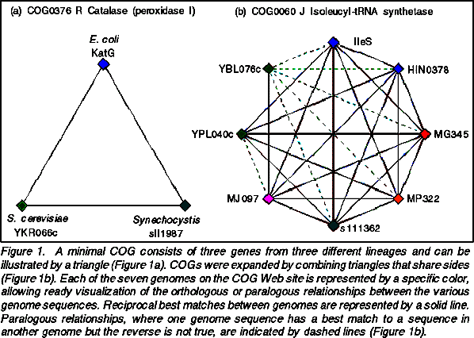
COG
COG (Clusters of Orthologous Groups; now POG, KOG, eggNOG etc.)
Graph extension of RBBH to clusters of mutual RBBH
“Any group of at least three proteins from different genomes, more similar to each other than any other proteins from those genomes, are an orthologous family.”
Conduct RBBH
Collapse paralogues
Detect “triangles”
Merge triangles having common side
Manual curation
Databases have many outparalogues
Tatusov et al. (2000) Nucl. Acids Res. doi:10.1093/nar/28.1.33

Slide 31
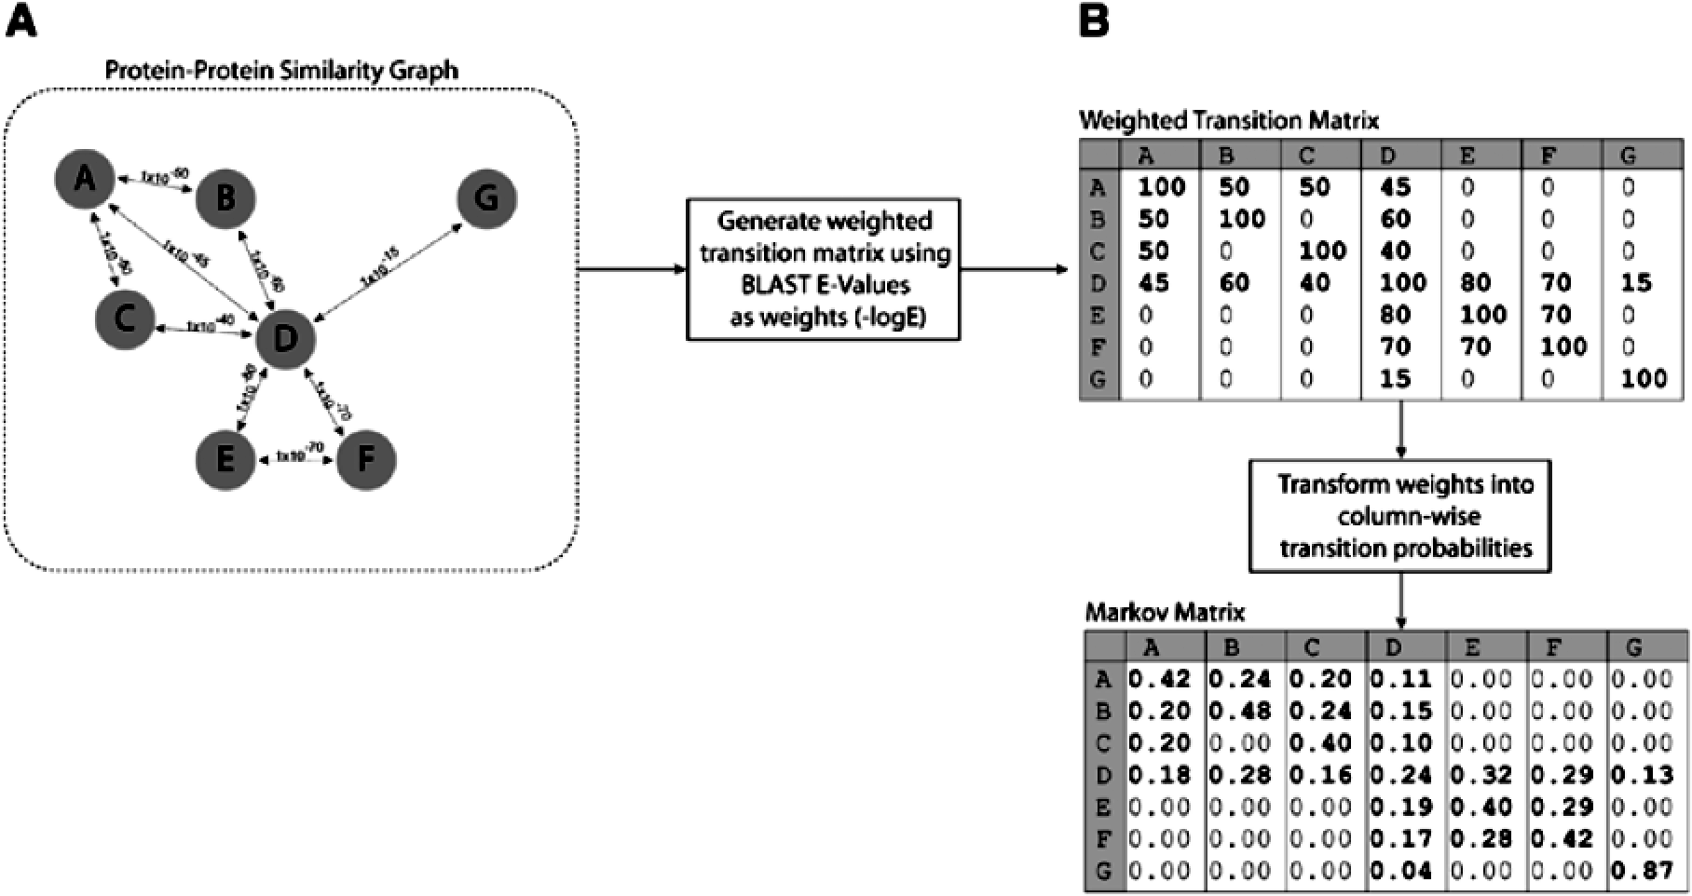
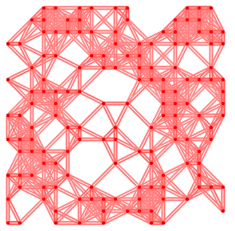
MCL
MCL constructs a network from all-vs-all BLAST results
Then applies matrix operations: expansion and inflation
Iterative expansion and inflation until network convergence
Enright et al. (2002) Nucl. Acids Res. doi:10.1093/nar/30.7.1575

Slide 32
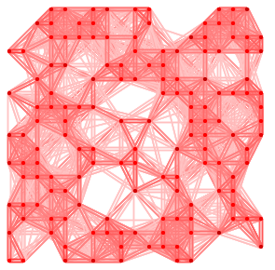
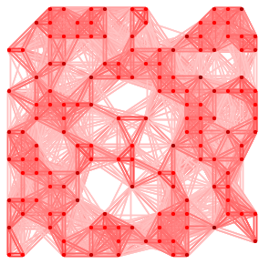
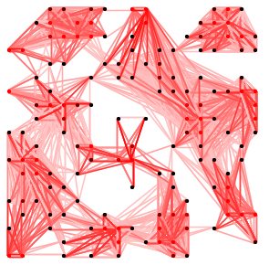
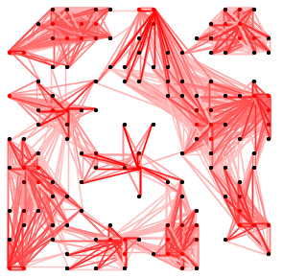
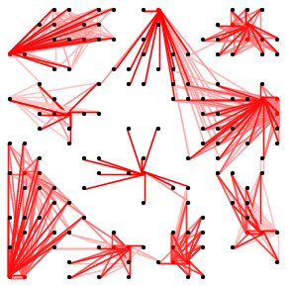
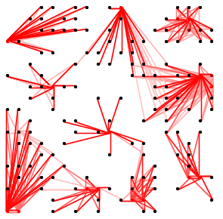
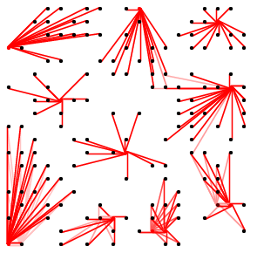
MCL
Expansion
Inflation
→
…
Input
…
…
Clustering
…
→

Slide 33
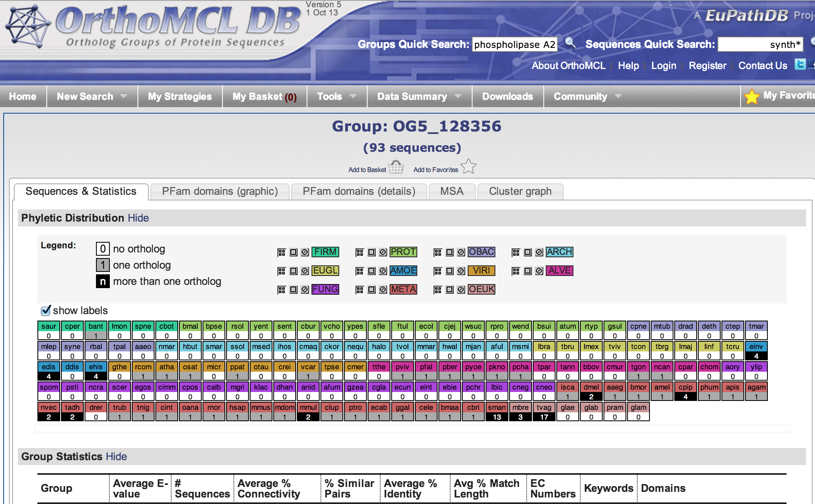
OrthoMCL
http://orthomcl.org/orthomcl/
Defines potential inparalogue, orthologue and co-orthologue pairs (using RBBH! – see algorithm description in papers directory)
Applies MCL to cluster inparalogue, orthologue, co-orthologue pairs/
Output clusters include both orthologues and paralogues
Li et al. (2003) Genome Res. doi:10.1101/gr.1224503

Slide 34
Notes of Caution
BLAST-based orthology methods (e.g. RBBH, InParanoid, COG) are fast!
But they have some drawbacks:
No guarantee that sequence matches are transitive (A may match B at a domain differently than B matches C)
No evolutionary distance model
Multiple domain matches are not accounted for
These methods find similar sequences, then make assumptions based on similarity and number of matches. They do not detect orthologues directly!
Tree-based methods incorporate:
Evolutionary distance
Direct orthologue detection

Slide 35
Finding “Orthologues”
Pairwise analysis: RBBH
[ACTIVITY]
find_rbbh.ipynb iPython notebook
Multi-organism analysis: MCL
[ACTIVITY]
mcl_orthologues/README.md Markdown
mcl_orthologues.ipynb iPython notebook

Slide 36
Other Methods
Synteny-based:
Homologene (NCBI):
http://www.ncbi.nlm.nih.gov/homologene
Manual curation:
Mouse Genome Database (MGD):
http://www.informatics.jax.org/homology.shtml
Tree-based:
EnsemblCompara (EMBL-EBI):
http://www.ensembl.org/info/genome/compara/index.html
TreeFam (EMBL-EBI):
http://www.treefam.org/
OrthologID:
http://nypg.bio.nyu.edu/orthologid/

Slide 37
Evaluating Orthologue Predictions
Which method works best?
(and what do we mean by “best” anyway?)

Slide 38
Evaluating Predictions
Works the same way for all prediction tools
Define a “validation set” (gold standard), unseen by the prediction tool
Make predictions with the tool
Evaluate confusion matrix and performance statistics
Sensitivity
Specificity
Accuracy
Standard: | +ve | -ve
Predict +ve | TP | FP
Predict -ve | FN | TN
False positive rate | FP/(FP+TN)
False negative rate | FN/(TP+FN)
Sensitivity | TP/(TP+FN)
Specificity | TN/(FP+TN)
False discovery rate (FDR) | FP/(FP+TP)
Accuracy | (TP+TN)/(TP+TN+FP+FN)

Slide 39
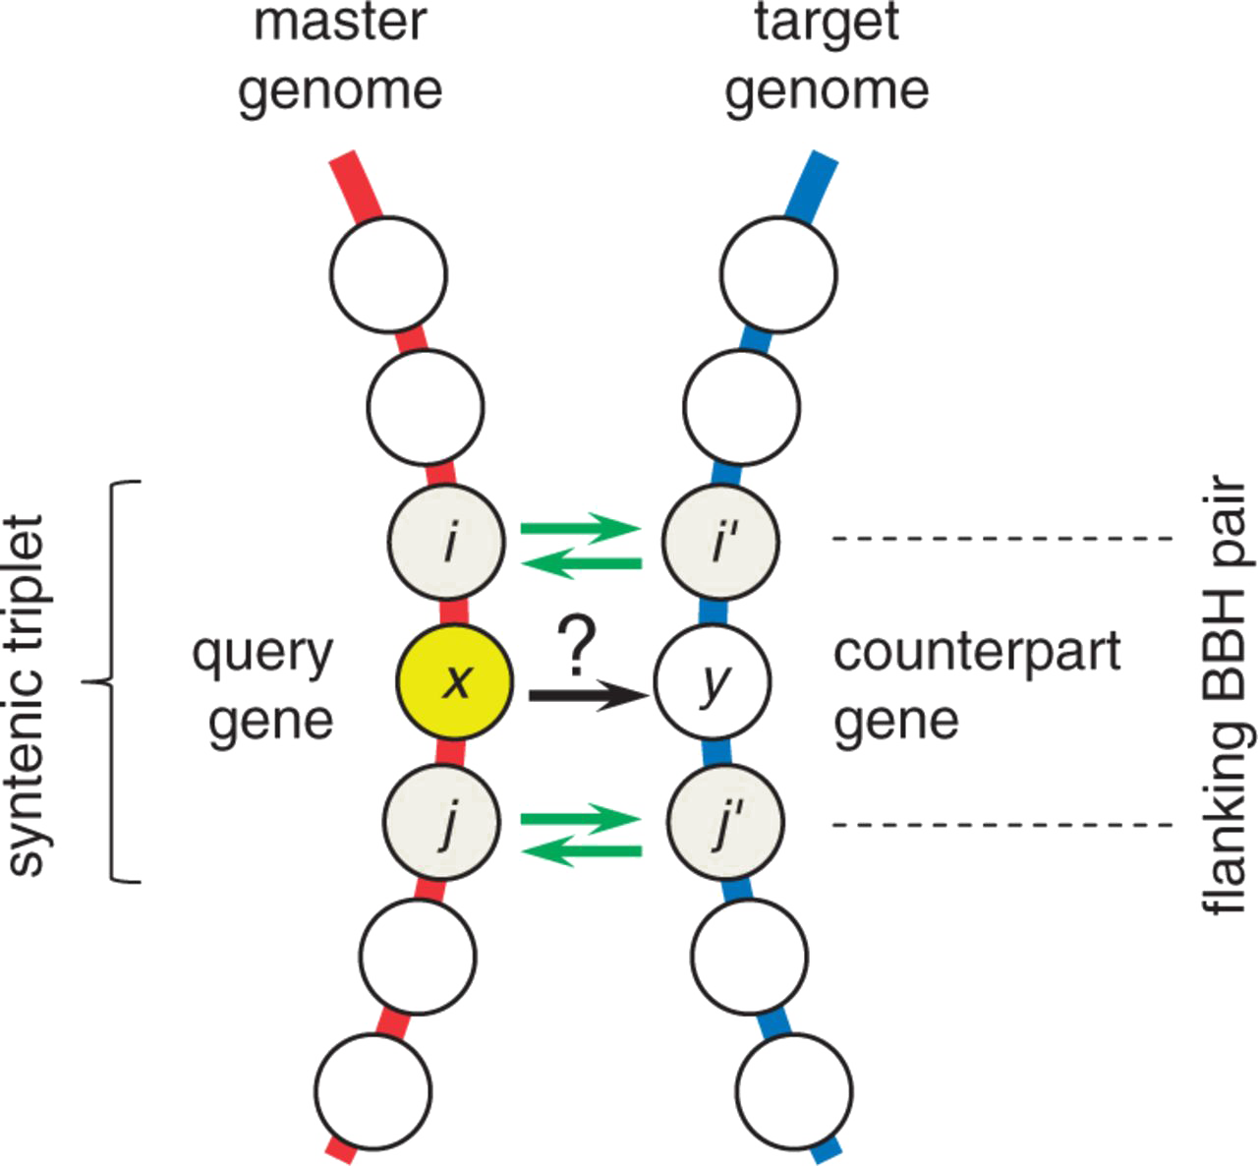
Evaluating Orthologue Predictions
Take advantage of prokaryotic operon structure: conserved syntenic triplets likely to be orthologous
Idea: If the outer pair in a syntenic triplet are orthologous, the middle gene is likely to be, too.
Middle genes are orthologue “gold standard”
Do RBBH reliably identify middle genes from syntenic triplets?
Wolf et al. (2012) Genome Biol. Evol. doi:10.1093/gbe/evs100

Slide 40
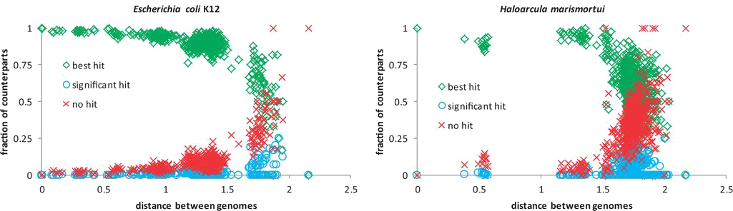
Evaluating Orthologue Predictions
Two well-characterised genomes compared against 573 prokaryotes
Identified RBBH (with permissive BLAST settings)
“Overwhelming majority” of middle genes (counterparts) are BBH
88-99% of BBH are in syntenic triplets
Therefore, RBBH reliably finds orthologues
Wolf et al. (2012) Genome Biol. Evol. doi:10.1093/gbe/evs100

Slide 41
Evaluating Orthologue Predictions
Four orthologue prediction algorithms:
RBBH (and cRBH)
RSD (and cRSD)
MultiParanoid
OrthoMCL
Tested against 2,723 curated orthologues from six Saccharomycetes
Rated by:
Sensitivity: TP/(TP+FN) – what proportion of orthologues are found
Specificity: TN/(TN+FP) – how well are non-orthologues excluded
Accuracy: (TP+TN)/(TP+TN+FP+FN) – general measure of performance
FDR: FP/(FP+TP) – what proportion of predictions are incorrect
Salichos et al. (2011) PLoS One. doi:10.1371/journal.pone.0018755

Slide 42
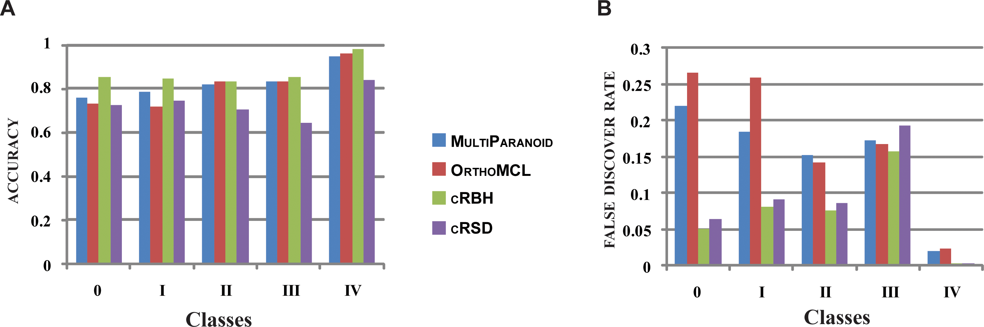
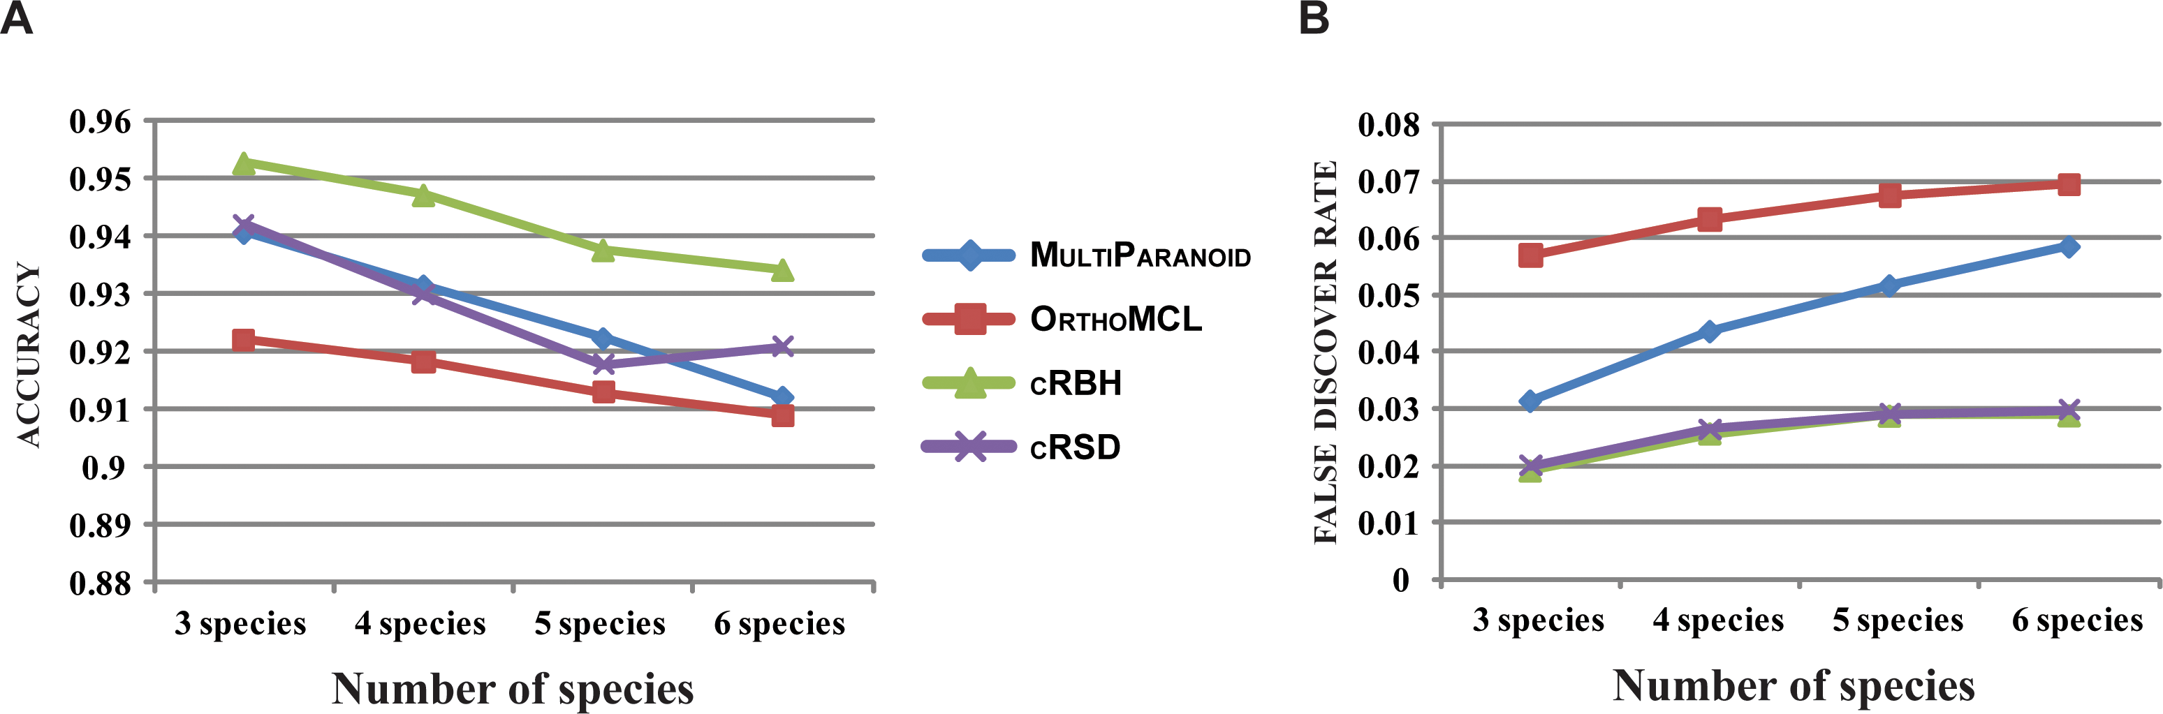
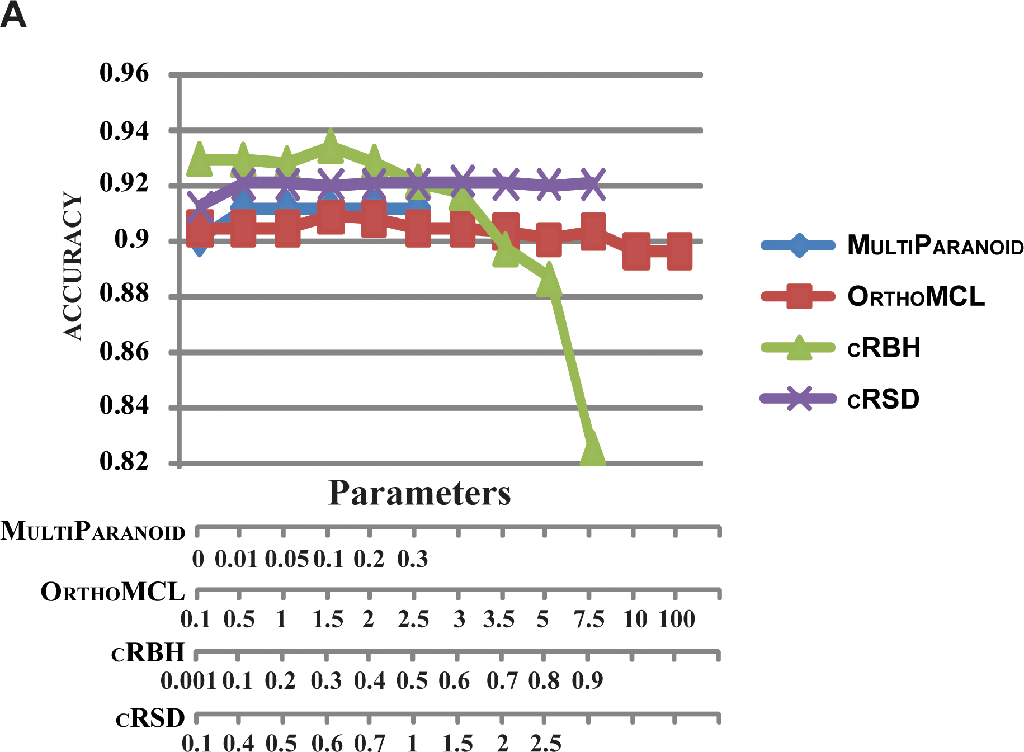
Evaluating Orthologue Predictions
Four orthologue prediction algorithms:
RBBH (cRBH)
RSD (cRSD)
MultiParanoid
OrthoMCL
cRBH most accurate, and specific, with lowest FDR
Salichos et al. (2011) PLoS One. doi:10.1371/journal.pone.0018755

Slide 43
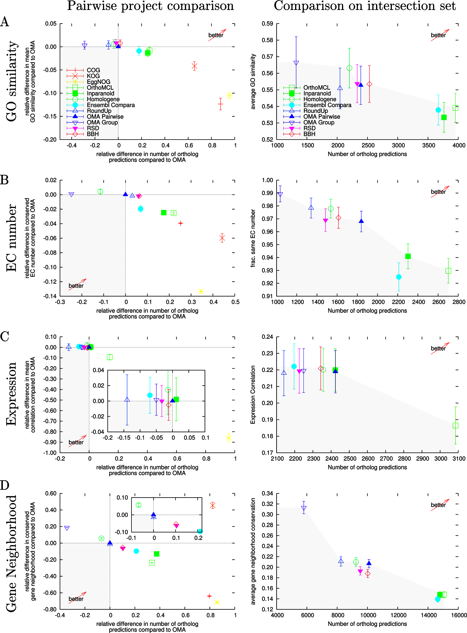
Evaluating Orthologue Predictions
Tests of several methods on a number of literature-based benchmarks for:
Correct branching of phylogeny
Grouping by function
GO similarity
EC number
Expression level
Gene Neighbourhood
Altenhoff & Dessimoz (2009) PLoS Comp. Biol. doi:10.1371/journal.pcbi.1000262

Slide 44
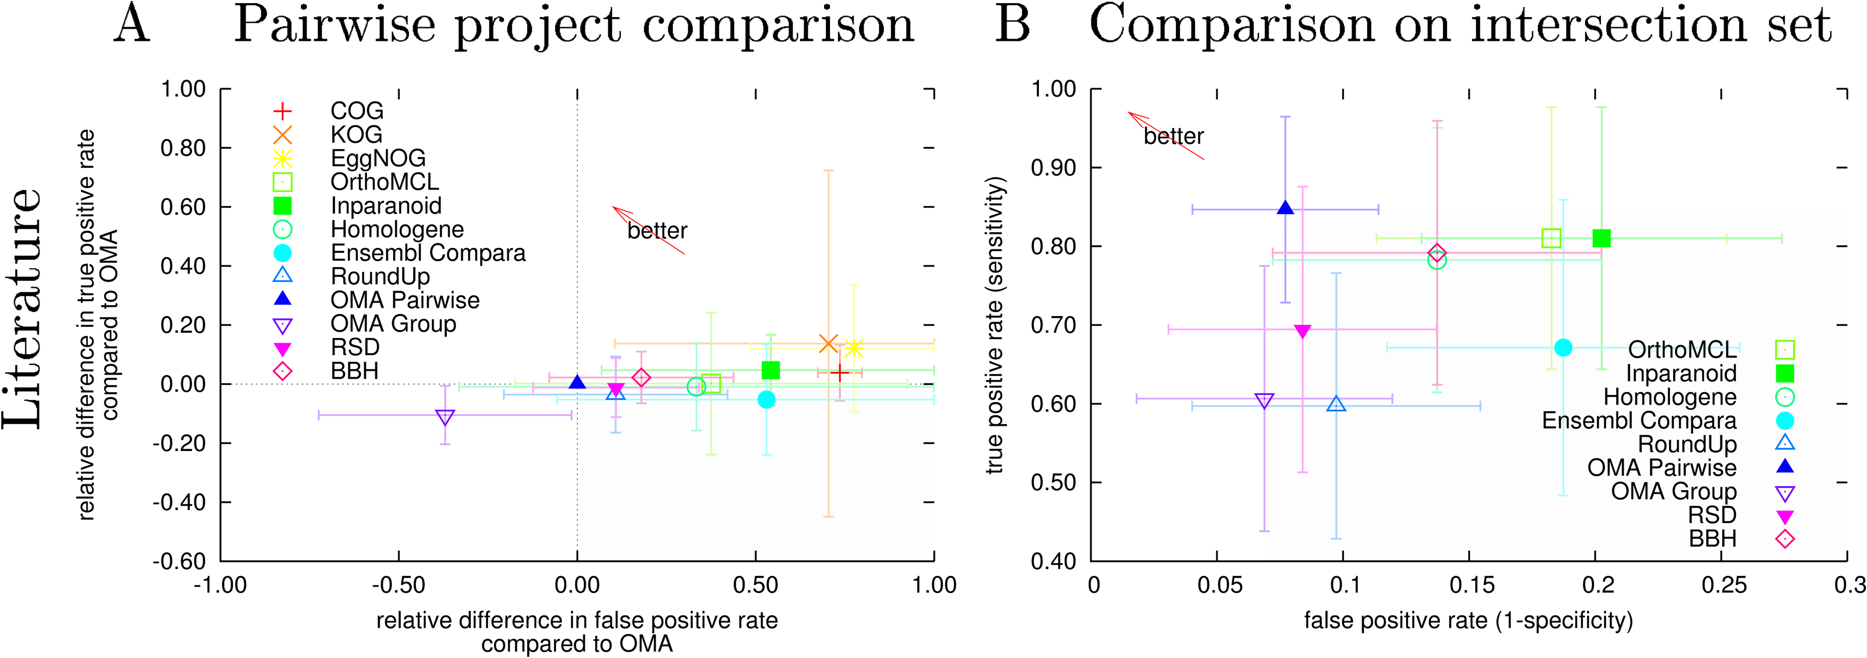
Evaluating Orthologue Predictions
Altenhoff & Dessimoz (2009) PLoS Comp. Biol. doi:10.1371/journal.pcbi.1000262

Slide 45
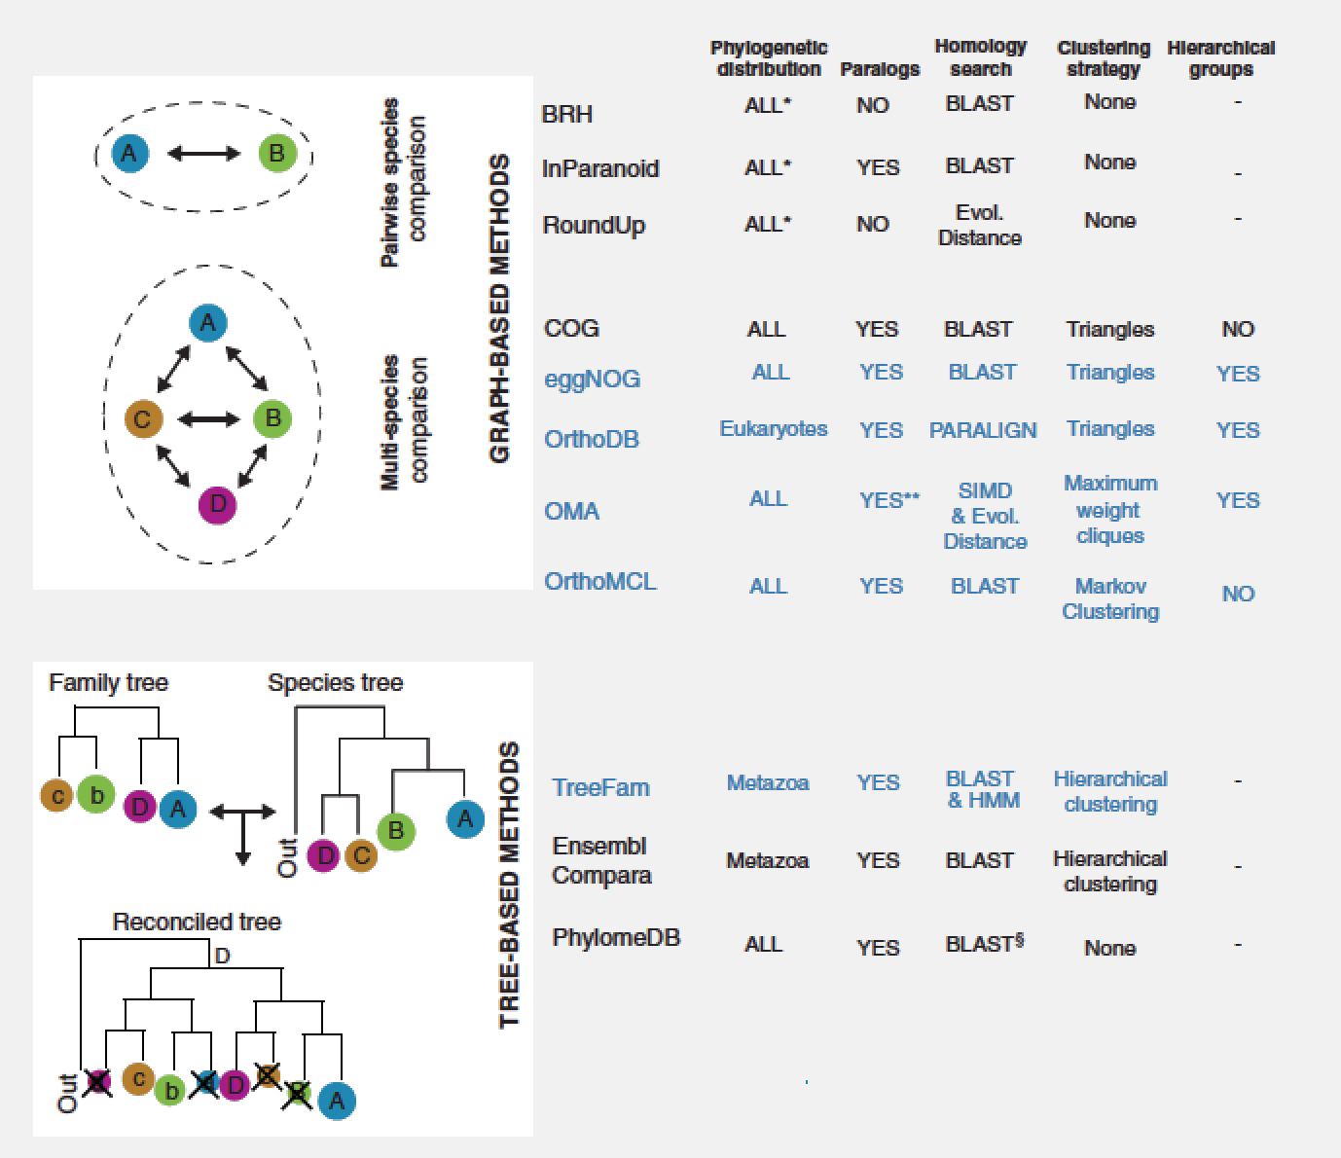
Evaluating Orthologue Predictions
70 gene family test, multiple evolutionary scenarios
Tested databases with associated algorithms:
Trachana et al. (2011) Bioessays. doi:10.1002/bies.201100062

Slide 46
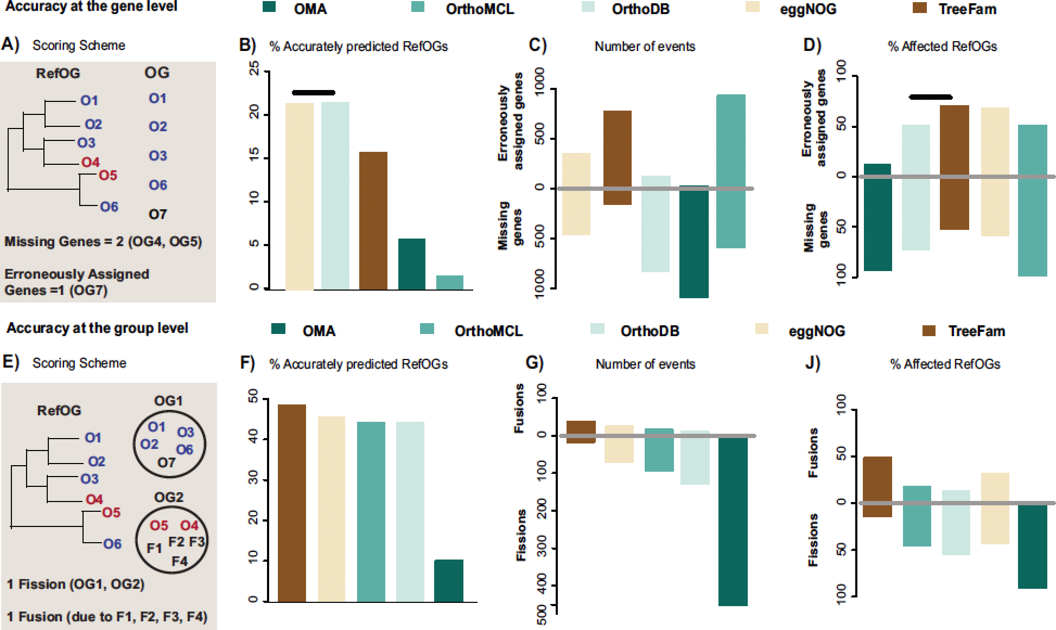
Evaluating Orthologue Predictions
70 gene family test set, multiple evolutionary scenarios
All methods/dbs have strong scope for improvement.
OrthoMCL poor performer, TreeFam & eggNOG do best
Trachana et al. (2011) Bioessays. doi:10.1002/bies.201100062

Slide 47
Orthologue Prediction Performance
Performance varies by choice of method and interpretation of “orthology”
Biggest influence is genome annotation quality
Relative performance varies with benchmark choice
(clustering) RBBH outperforms more complex algorithms under many circumstances

Slide 48
Selection Pressures
Signs of selection pressure identifiable by comparative genomics

Slide 49
Selection Pressures
Defining core groups of genes by “orthology” allows analysis of those groups:
Synteny/collocation
Gene neighbourhood changes (e.g. genome expansion)
The pangenome: core and accessory genomes
and sequences in those groups:
Multiple alignment
Domain detection
Identification of functional sites
Inference of evolutionary pressures

Slide 50
Synteny
Selective pressures depend on gene (product) function
Genes involving physically or functionally-interacting proteins tend to evolve under similar selective constraints
Particularly in bacteria, this leads to co-expression as regulons and collocation in operons
Collocation (and coregulation) may be identified by comparative genomics
(This is also true when considering regulatory or metabolic networks, similarly to genome organisation)
Alvarez-Ponce et al. (2011) Genome Biol. Evol. doi:10.1093/gbe/evq084

Slide 51
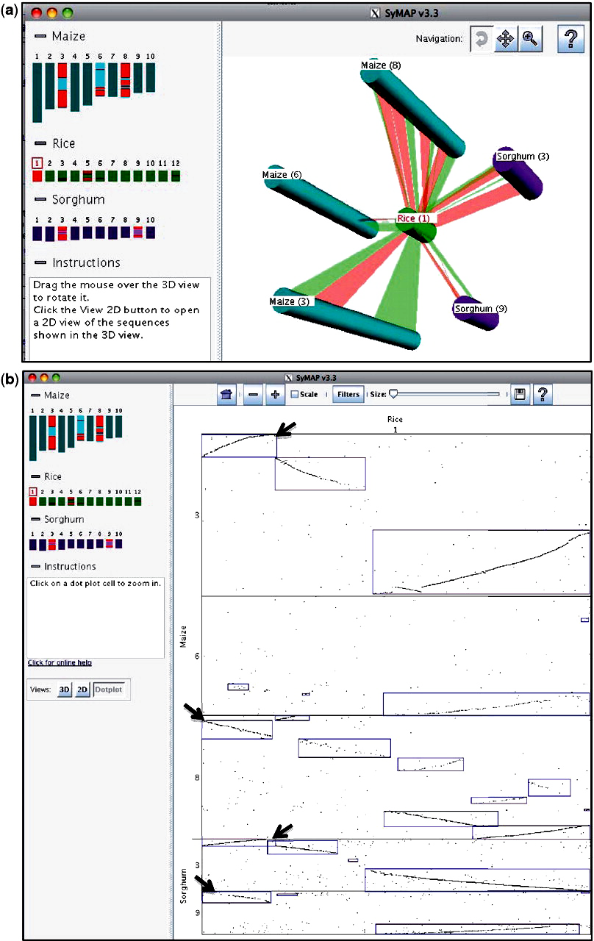
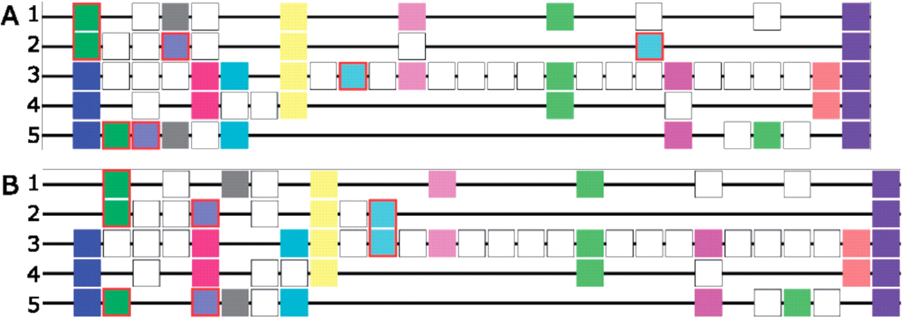
Synteny
Many tools/packages/services for synteny detection, e.g.
SyMAP
http://www.agcol.arizona.edu/software/symap/
i-ADHoRe
http://bioinformatics.psb.ugent.be/software/details/i--ADHoRe
MCScan, Cyntenator, etc
Soderlund et al. (2011) Nucl. Acids. Res. doi:10.1093/nar/gkr123
Proost et al. (2011) Nucl. Acids Res. doi:10.1093/nar/gkr955

Slide 52
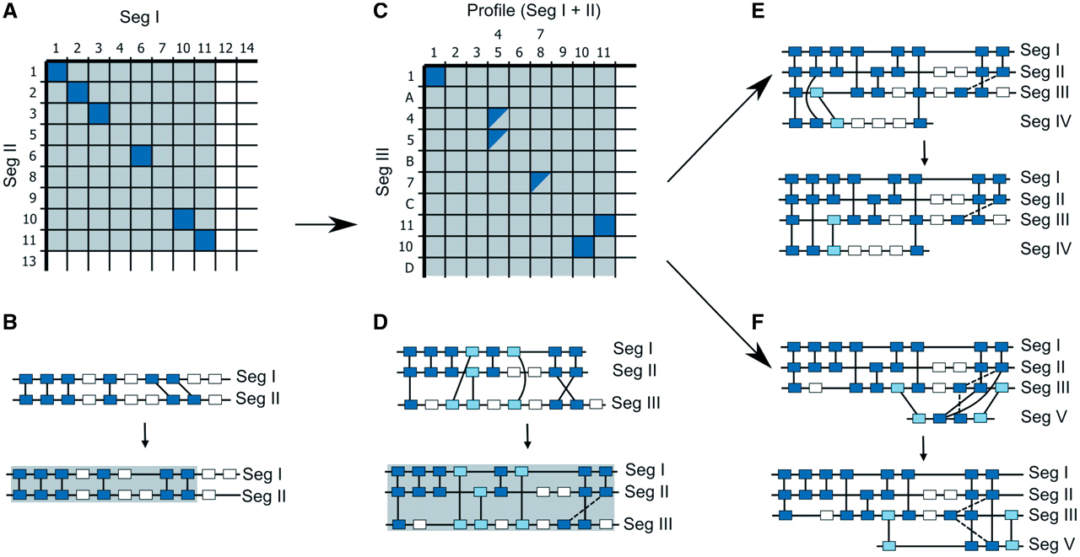
i-ADHoRe
Algorithm:
Combine tandem repeats of genes/gene sets
Make gene homology matrix (GHM): identify collinear regions (diagonals) for first genome pair
Convert these to profiles
Use GG2 algorithm to align profiles
Search next genome with profiles, splitting them where necessary
iterate until complete
Gives genome-scale multiple alignments of blocks of genes
Proost et al. (2011) Nucl. Acids Res. doi:10.1093/nar/gkr955

Slide 53
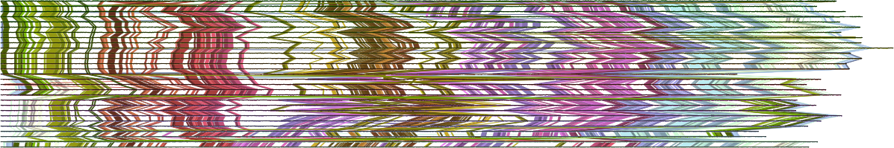
i-ADHoRe
[ACTIVITY]
i-ADHoRe/README.md Markdown
i-ADHoRe.ipynb iPython notebook

Slide 54
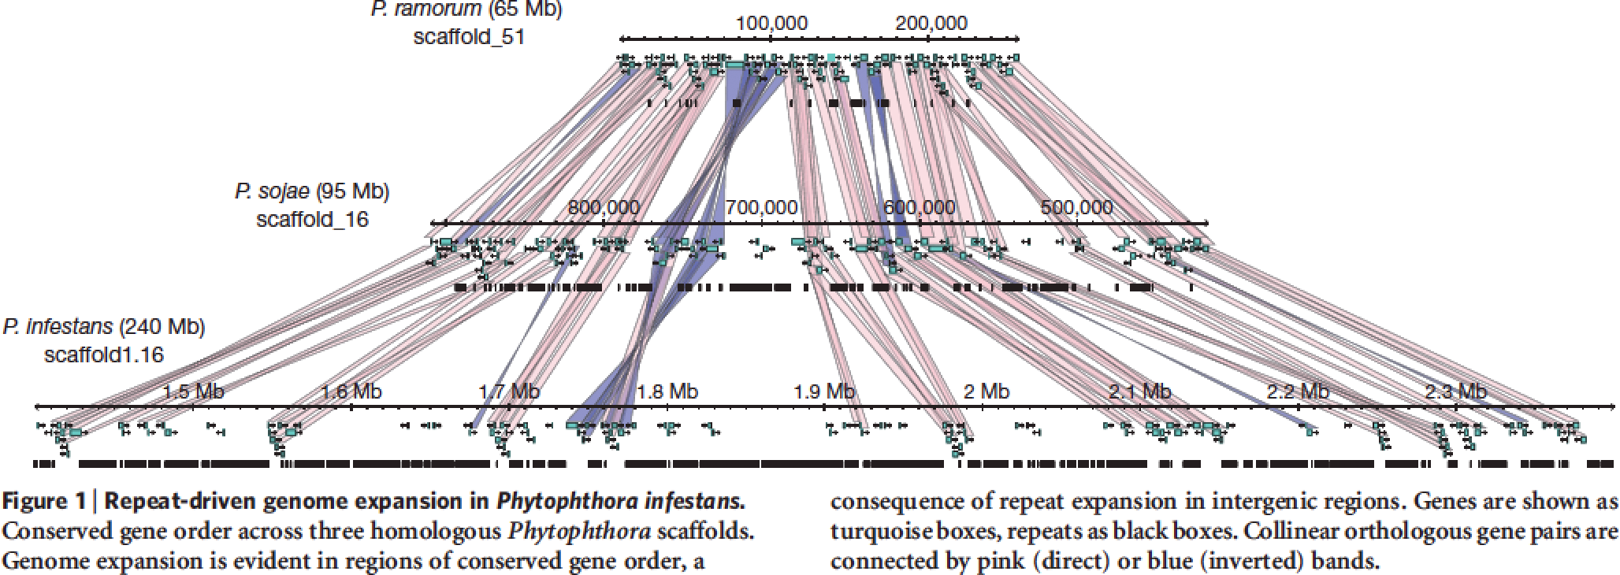
Genome Expansion
Mobile/repeat elements reproduce and expand during evolution
Generates sequence “laboratory” for variation and experiment
e.g. Phytophthora infestans effector protein expansion and arms race
Haas et al. (2009) Nature. doi:10.1038/nature08358

Slide 55
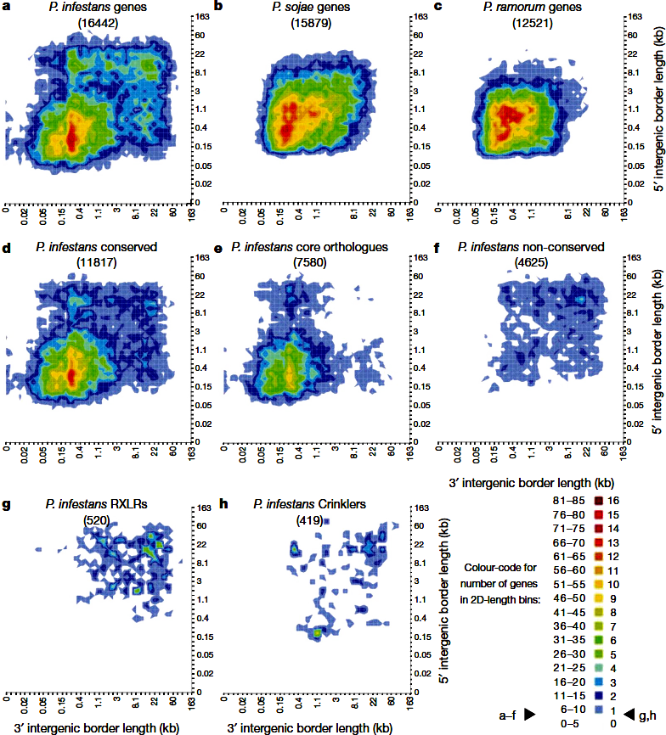
Genome Expansion
Mobile elements (MEs) are large, carry genes with them.
Regions rich in MEs have larger gaps between consecutive genes
Effector proteins are found preferentially in regions with large gaps, also show increased rates of evolutionary divergence.
“Two-speed genome” associated with adaptability to new hosts/escape from evolutionary “bottleneck”
Haas et al. (2009) Nature. doi:10.1038/nature08358

Slide 56
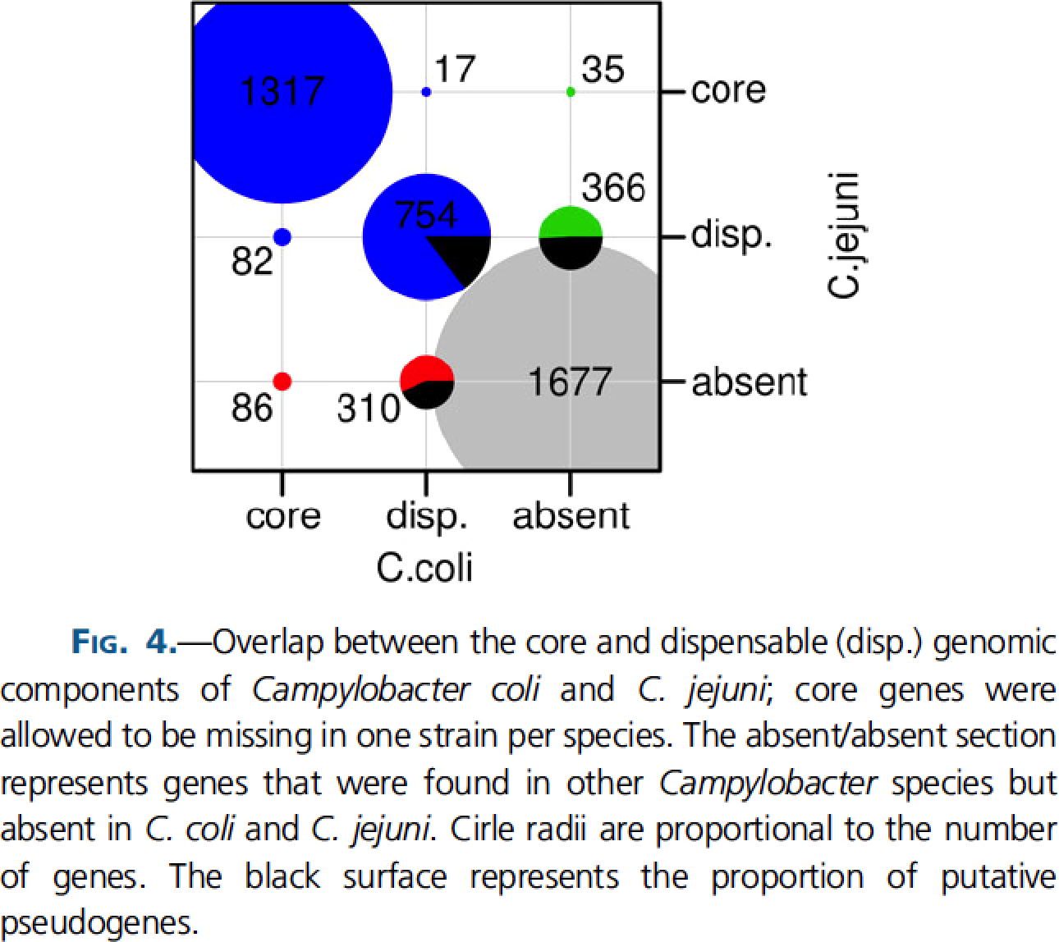
The Pangenome
The gene complement of a set of organisms (e.g. species group) is the pangenome, defined by the union of two gene sets:
Core genes: genes present in all examples (define common species characteristics)
Accessory genes: genes only present in a subset of examples (relevant to adaptation of individuals)
Definition depends on composition of organism set
Core genome hypothesis:
“The core genome is the primary cohesive unit defining a bacterial species.”
Online tools available, e.g.
Panseq (http://lfz.corefacility.ca/panseq/)
Laing et al. (2010) BMC Bioinf. doi:10.1186/1471-2105-11-461
Lefébure et al. (2010) Genome Biol. Evol. doi:10.1093/gbe/evq048

Slide 57
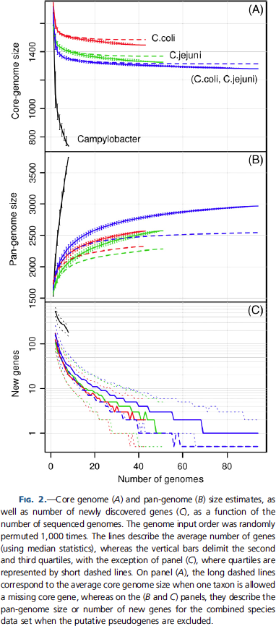
Defining a species’ core genome
“Orthologue groups” with a representative in (nearly) every member of the set
But we only have a sample of the species, not every member…
…so use rarefaction curves to estimate core genome size.
Randomly order organisms, and count number of ‘core’ and ‘new’ genes seen with each new genome addition.
Repeat until you have a reasonable estimate of error/no new genes found
Lefébure et al. (2010) Genome Biol. Evol. doi:10.1093/gbe/evq048

Slide 58
Directional Selection
Several statistical tests for directional selection, e.g.
QTL sign
K_{a}/K_{s} (d_{N}/d_{S}) ratio test – most commonly applied
Relative rate test
K_{a}/K_{s} ratio:
K_{a} (or d_{N}): number of non-synonymous substitutions per non-synonymous site
K_{s} (or d_{S}): number of synonymous substitutions per synonymous site
Ka/Ks > 1 ⇒ positive selection; Ka/Ks < 1 ⇒ stabilising selection
Several methods/tools for calculation
PAML (http://abacus.gene.ucl.ac.uk/software/paml.html)
SeqinR (http://cran.r-project.org/web/packages/seqinr/index.html)

Slide 59
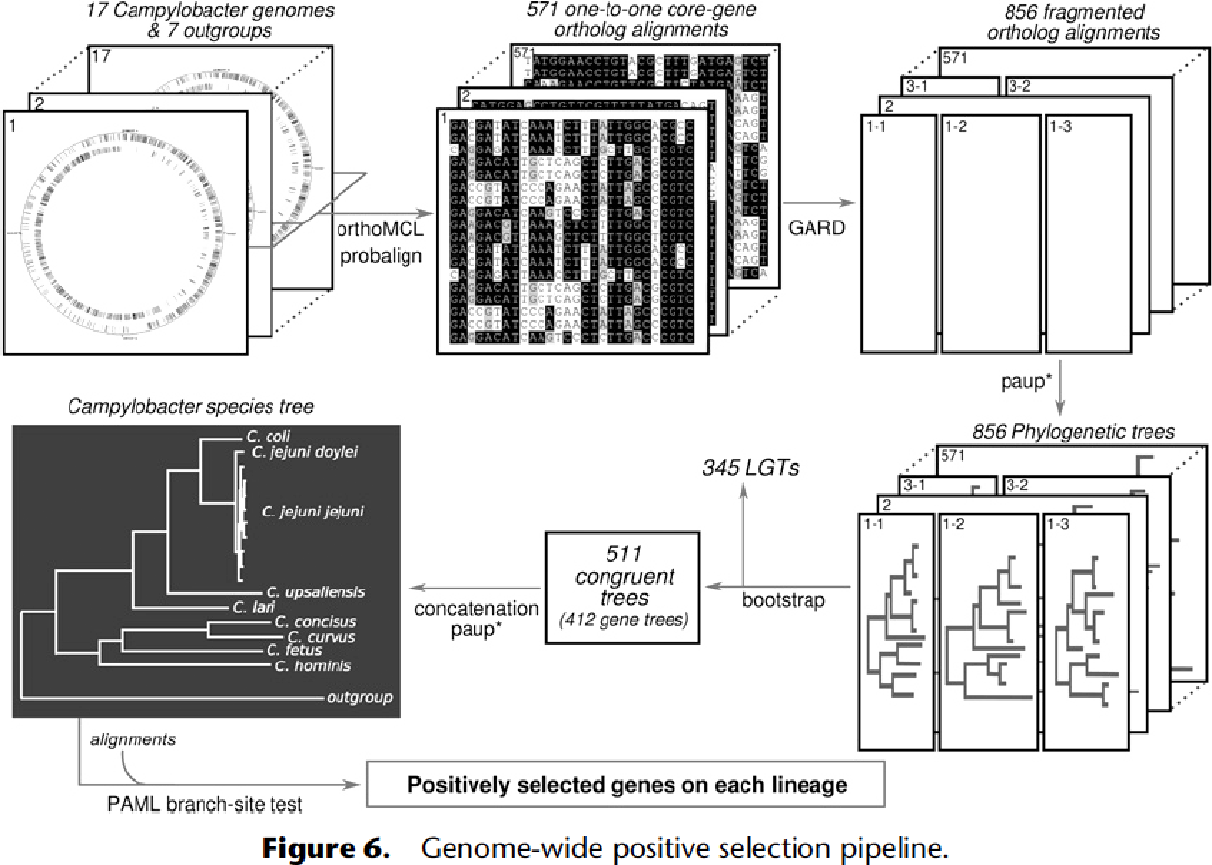
Genome-Wide Positive Selection
Lefébure & Stanhope (2009) Genome Res. doi:10.1101/gr.089250.108

Slide 60
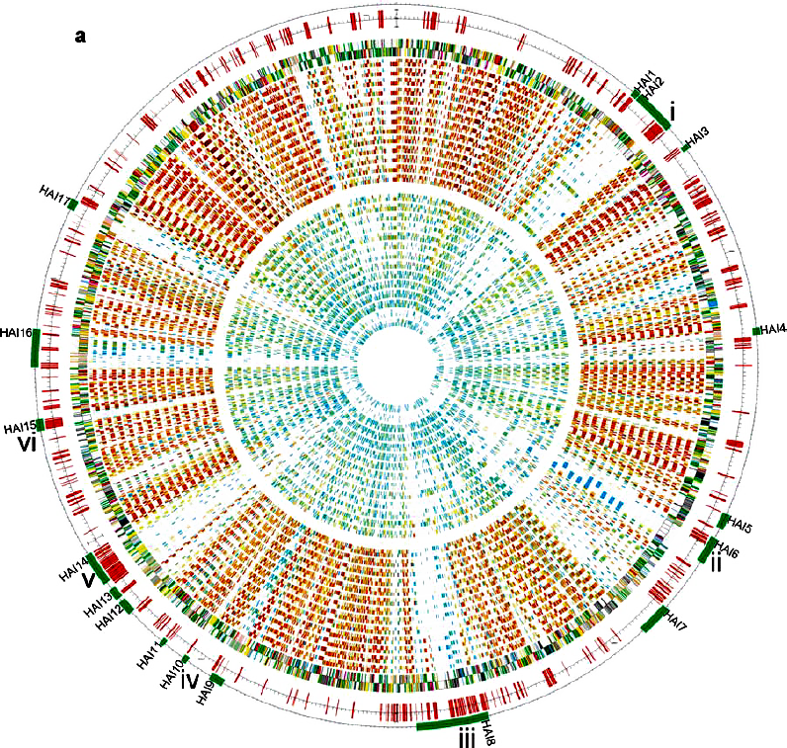
An Analysis Output
Class comparison: animal-pathogenic (APE) vs plant-associated bacteria (PAB)
Presence of horizontally-acquired islands (HAI)
Genes with greater similarity to PAB than APE
Toth et al. (2006) Annu. Rev. Phytopath. doi:10.1146/annurev.phyto.44.070505.143444

Slide 61
Things I Didn’t Get To
Genome-Wide Association Studies (GWAS):
Try http://genenetwork.org/ to play with some data
Prediction of regulatory elements, e.g.
Kellis et al. (2003) Nature doi:10.1038/nature01644
King et al. (2007) Genome Res. doi:10.1101/gr.5592107
Chaivorapol et al. (2008) BMC Bioinf. doi:10.1186/1471-2105-9-455
CompMOBY: http://genome.ucsf.edu/compmoby/
Detection of Horizontal/Lateral Gene Transfer (HGT/LGT), e.g.
Tsirigos & Rigoutsos (2005) Nucl. Acids. Res. doi:10.1093/nar/gki187
Phylogenomics, e.g.
Delsuc et al. (2005) Nat. Rev. Genet. doi:10.1038/nrg1603

Slide 62
Finishing The Hat
Some of the things I hope you have taken away from the lectures/activities

Slide 63
Take-Home Messages
Comparative genomics is a powerful set of techniques for:
Understanding and identifying evolutionary processes and mechanisms
Reconstructing detailed evolutionary history of a set of organisms
Identifying and understanding common genomic features of organisms
Providing hypotheses about gene function for experimental investigation
A huge amount of data is available to work with
And it’s only going to get much, much larger
Results feed into many areas of study:
Medicine and health
Agriculture and food security
Basic biology in all fields
Systems and synthetic biology

Slide 64
Take-Home Messages
Comparative genomics is essentially based around comparisons
What is similar between two genomes? What is different?
Comparative genomics is evolutionary genomics
Large datasets benefit from visualisation for effective interpretation
Much scope for improvement in visualisation
Tools with the same purpose give different output
BLAST vs MUMmer
RBBH vs MCL
Choice of application matters for correctness and interpretation! – understand what the application does, and its limits.

Slide 65
Take-Home Messages
Comparative genomics is
Fun
Indoor work, in the warm and dry
Not a job that involves heavy lifting

